Slide 1

Module2.1
PRE-CLASS CONTENT
Normal forms
Disjunctive Normal Form
Conjunctive Normal Form
Principal Disjunctive Normal Form
Principal Conjunctive Normal Form

Slide 2
NORMAL FORMS
WHY NORMAL FORMS?
If the number of variables involved in a given statement are more, the construction of truth tables become tedious. In these situations we consider other method known as reduction to normal form.
NOTE
In this method we use
Product in place of conjunction
Sum in place of disjunction

Slide 3
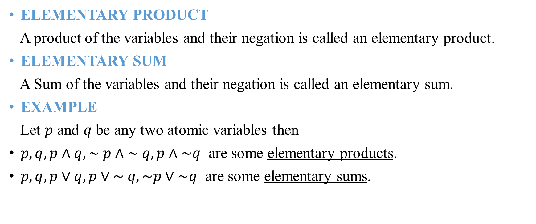
ELEMENTARY PRODUCT & ELEMENTARY SUM
ELEMENTARY PRODUCT
A product of the variables and their negation is called an elementary product.
ELEMENTARY SUM
A Sum of the variables and their negation is called an elementary sum.
EXAMPLE
Let $p$ and $q$ be any two atomic variables then
$p, q, p∧q, \sim p∧\sim q, p∧\sim q$ are some elementary products.
$p, q, p∨q, p∨\sim q, \sim p∨\sim q$ are some elementary sums.

Slide 4
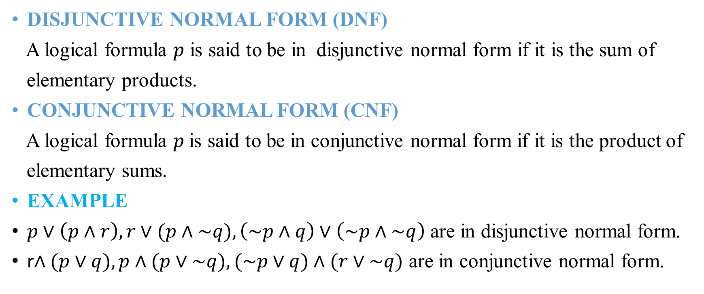
DISJUNCTIVE NORMAL FORM & CONJUNCTIVE NORMAL FORM
DISJUNCTIVE NORMAL FORM (DNF)
A logical formula $p$ is said to be in disjunctive normal form if it is the sum of
elementary products.
CONJUNCTIVE NORMAL FORM (CNF)
A logical formula $p$is said to be in conjunctive normal form if it is the product of
elementary sums.
EXAMPLE
$p∨\left(p∧r\right),r∨(p∧\sim q), \left(\sim p∧q\right)∨\left(\sim p∧\sim q\right)$ are in disjunctive normal form.
r$∧(p∨q), p∧(p∨\sim q), (\sim p∨q)∧(r∨\sim q)$ are in conjunctive normal form.

Slide 5
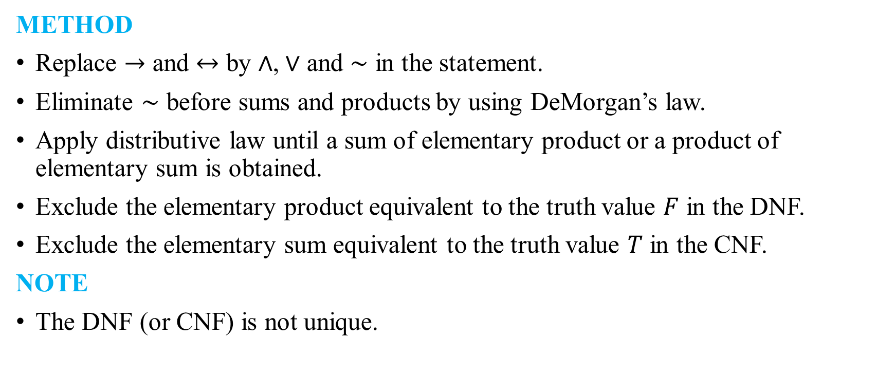
METHOD TO OBTAIN DNF OR CNF
METHOD
Replace $→$ and $↔$ by $∧$, $∨$ and $\sim$ in the statement.
Eliminate $\sim$ before sums and products by using DeMorgan’s law.
Apply distributive law until a sum of elementary product or a product of elementary sum is obtained.
Exclude the elementary product equivalent to the truth value $F$ in the DNF.
Exclude the elementary sum equivalent to the truth value $T$ in the CNF.
NOTE
The DNF (or CNF) is not unique.

Slide 6
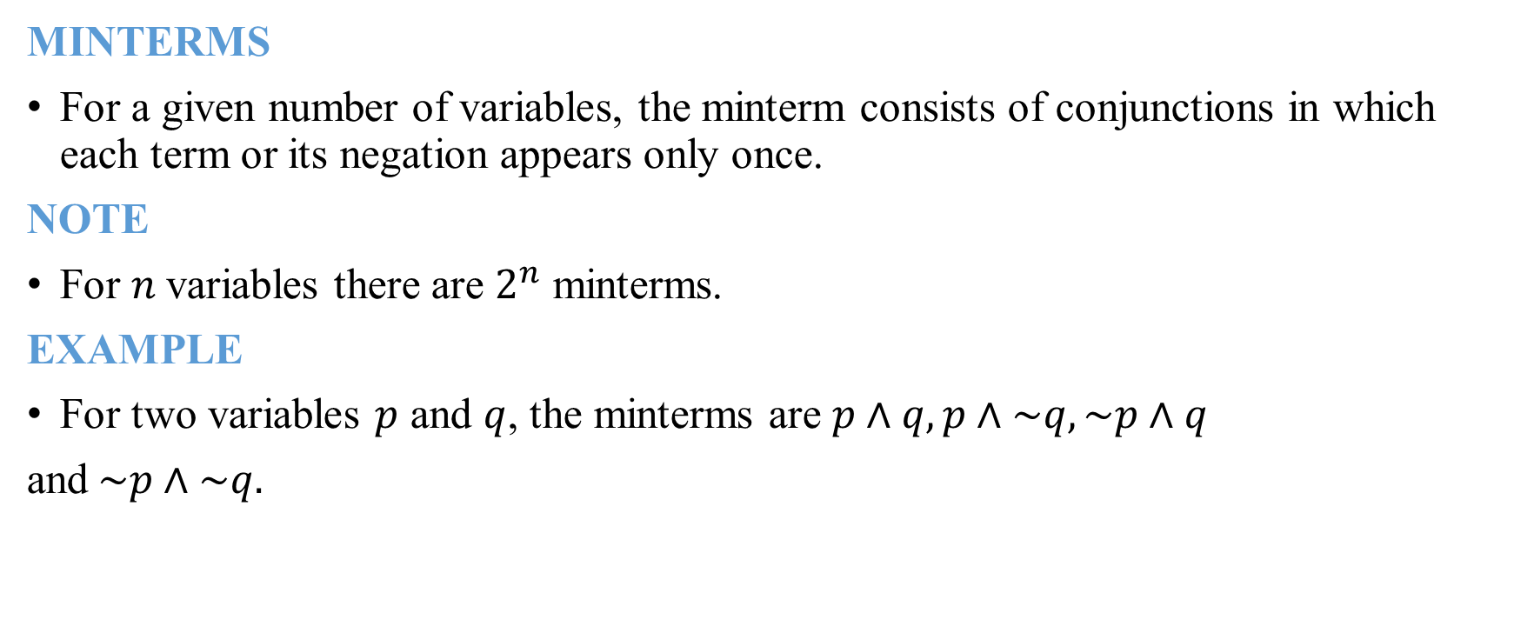
MINTERMS
MINTERMS
For a given number of variables, the minterm consists of conjunctions in which each term or its negation appears only once.
NOTE
For $n$variables there are $2^{n}$ minterms.
EXAMPLE
For two variables $p$ and $q$, the minterms are $p∧q, p∧\sim q, \sim p∧q$
and$\sim p∧\sim q.$

Slide 7

MAXTERMS
MAXTERMS
For a given number of variables, the maxterm consists of disjunctions in which each term or its negation appears only once.
NOTE
For $n$variables there are $2^{n}$ maxterms.
EXAMPLE
For two variables $p$ and $q$, the maxterms are $p∨q, p∨\sim q, \sim p∨q$
and$\sim p∨\sim q.$

Slide 8
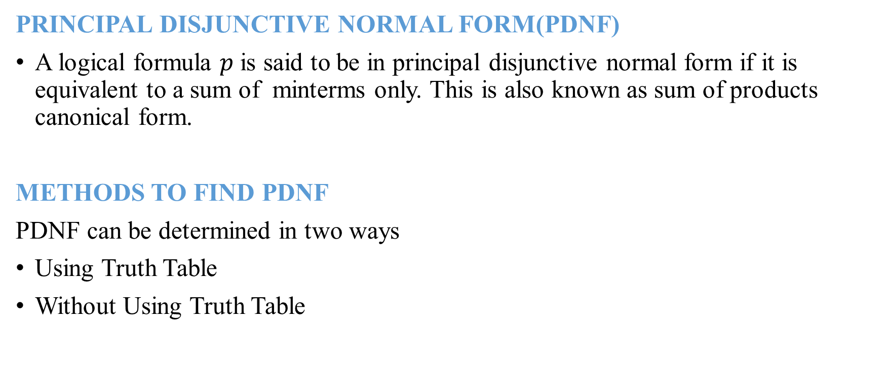
PRINCIPAL DISJUNCTIVE NORMAL FORM
PRINCIPAL DISJUNCTIVE NORMAL FORM(PDNF)
A logical formula $p$ is said to be in principal disjunctive normal form if it is equivalent to a sum of minterms only. This is also known as sum of products canonical form.
METHODS TO FIND PDNF
PDNF can be determined in two ways
Using Truth Table
Without Using Truth Table

Slide 9

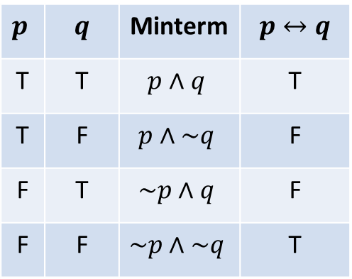
PDNF USING TRUTH TABLE
EXAMPLE: Obtain the principal disjunctive normal form of $p↔q$
Construct truth table for $p↔q$
Now the PDNF of $p↔q$ is $(p∧q)∨(\sim p∧\sim q)$
$p$ | $$q$$ | Minterm | $$p↔q$$
T | T | $$p∧q$$ | T
T | F | $$p∧\sim q$$ | F
F | T | $$\sim p∧q$$ | F
F | F | $$\sim p∧\sim q$$ | T

Slide 10
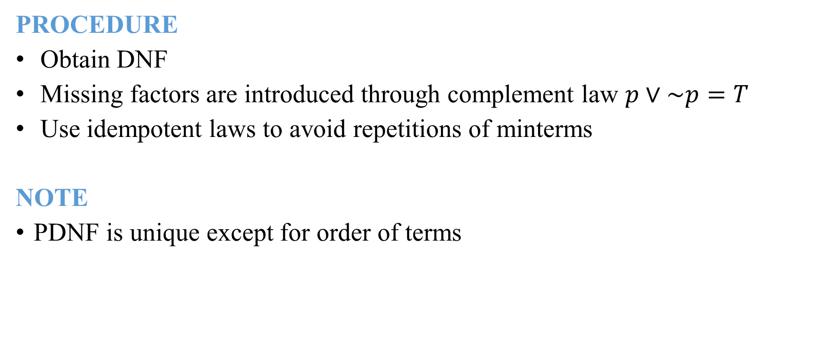
PDNF WITHOUT USING TRUTH TABLE
PROCEDURE
Obtain DNF
Missing factors are introduced through complement law $p∨\sim p=T$
Use idempotent laws to avoid repetitions of minterms
NOTE
PDNF is unique except for order of terms

Slide 11
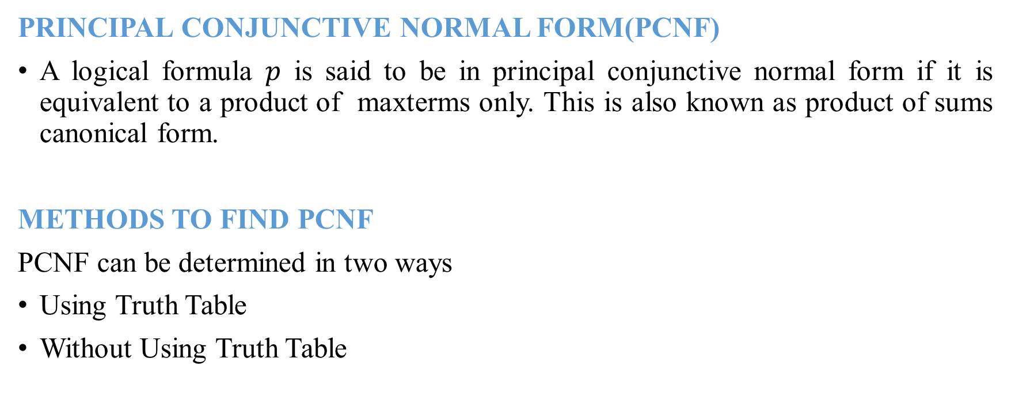
PRINCIPAL CONJUNCTIVE NORMAL FORM
PRINCIPAL CONJUNCTIVE NORMAL FORM(PCNF)
A logical formula $p$ is said to be in principal conjunctive normal form if it is equivalent to a product of maxterms only. This is also known as product of sums canonical form.
METHODS TO FIND PCNF
PCNF can be determined in two ways
Using Truth Table
Without Using Truth Table

Slide 12

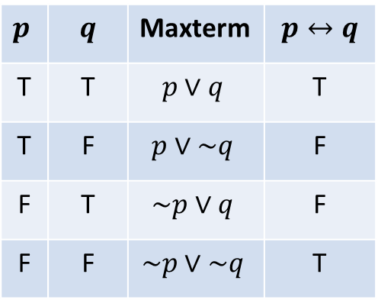
PCNF USING TRUTH TABLE
EXAMPLE: Obtain the principal conjunctive normal form of $p↔q$
Construct truth table for $p↔q$
Now the PCNF of $p↔q$ is $(p∨\sim q)∧(\sim p∨q)$
$p$ | $$q$$ | Maxterm | $$p↔q$$
T | T | $$p∨q$$ | T
T | F | $$p∨\sim q$$ | F
F | T | $$\sim p∨q$$ | F
F | F | $$\sim p∨\sim q$$ | T

Slide 13
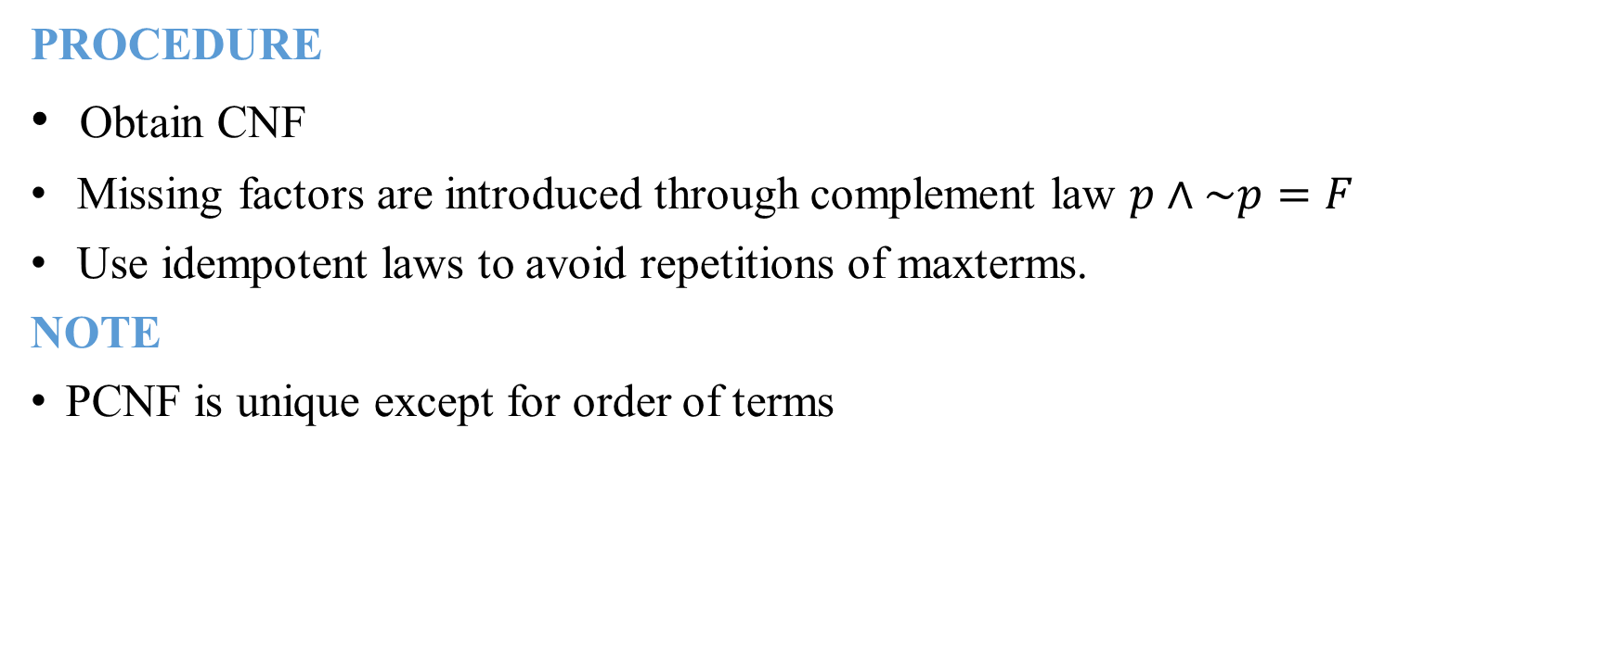
PCNF WITHOUT USING TRUTH TABLE
PROCEDURE
Obtain CNF
Missing factors are introduced through complement law $p∧\sim p=F$
Use idempotent laws to avoid repetitions of maxterms.
NOTE
PCNF is unique except for order of terms

Slide 14
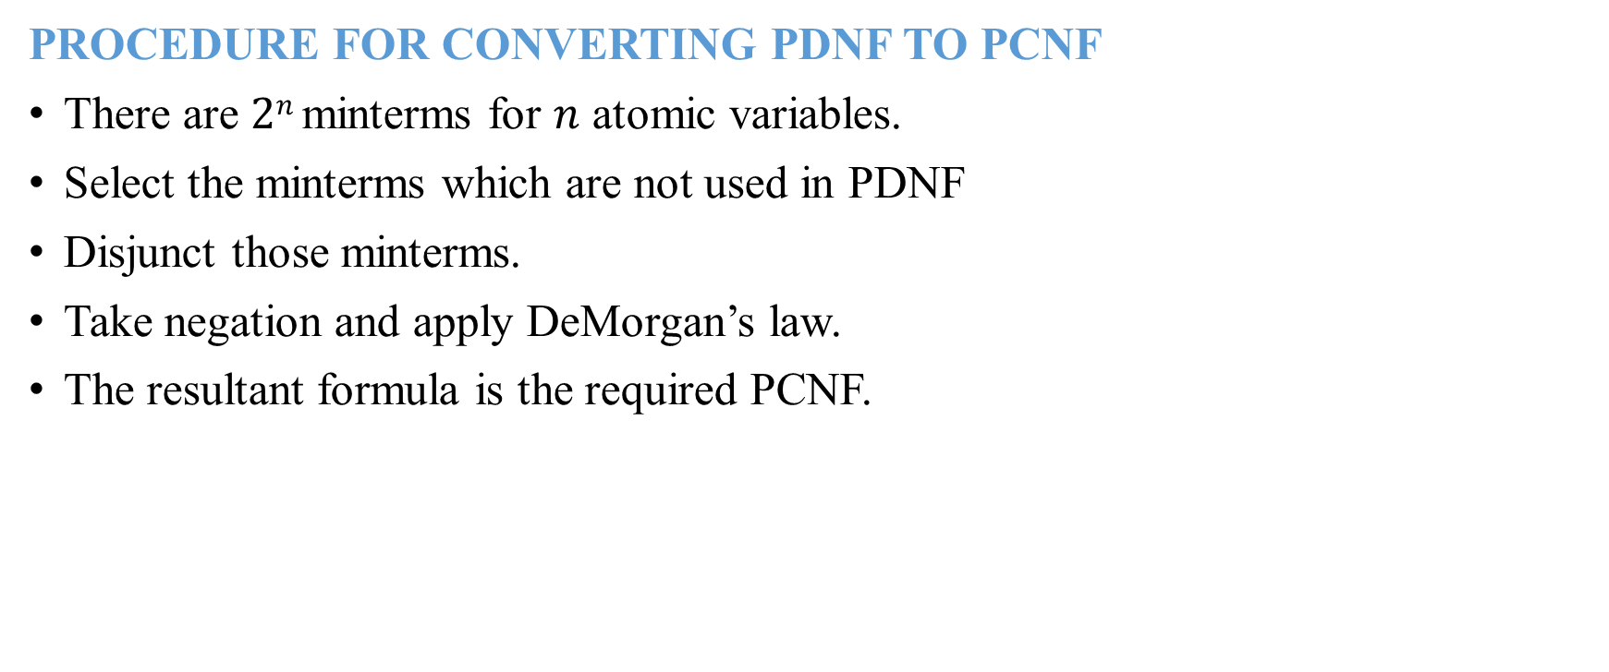
CONVERSION OF PDNF TO PCNF
PROCEDURE FOR CONVERTING PDNF TO PCNF
There are $2n$ minterms for $n$ atomic variables.
Select the minterms which are not used in PDNF
Disjunct those minterms.
Take negation and apply DeMorgan’s law.
The resultant formula is the required PCNF.

Slide 15
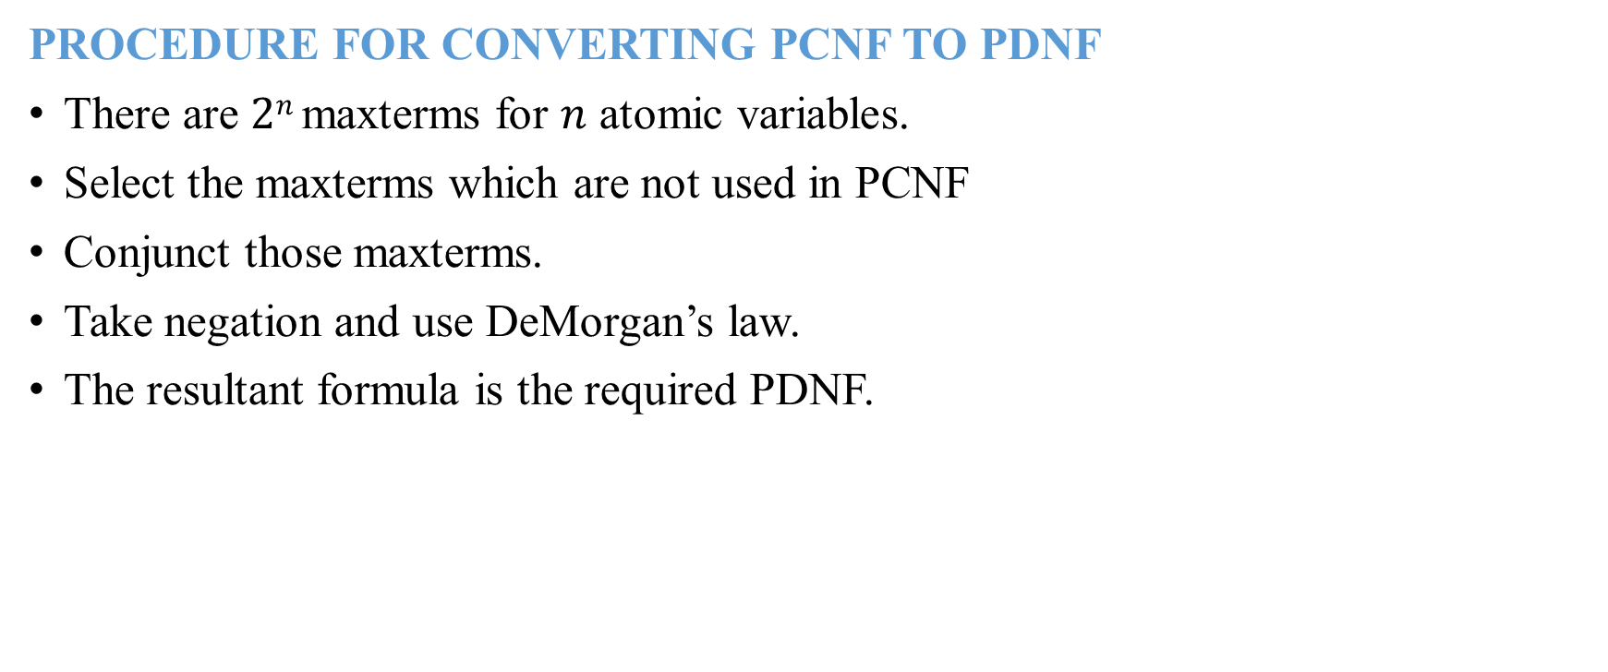
CONVERSION OF PCNF TO PDNF
PROCEDURE FOR CONVERTING PCNF TO PDNF
There are $2n$ maxterms for $n$ atomic variables.
Select the maxterms which are not used in PCNF
Conjunct those maxterms.
Take negation and use DeMorgan’s law.
The resultant formula is the required PDNF.

Slide 16
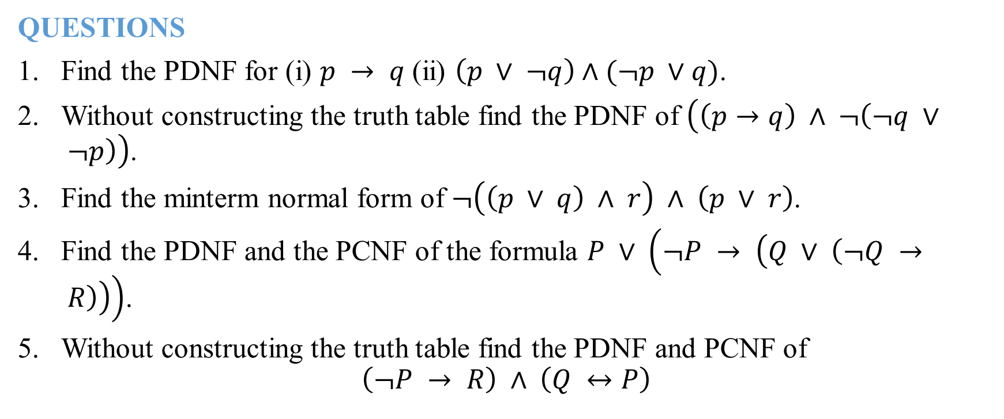
PROBLEMS
QUESTIONS
Find the PDNF for (i) $p → q$ (ii) $\left(p ∨ ¬q\right)∧(¬p ∨q)$.
Without constructing the truth table find the PDNF of $\left(\left(p→q\right) ∧ ¬\left(¬q ∨ ¬p\right)\right)$.
Find the minterm normal form of $¬\left(\left(p ∨ q\right) ∧ r\right) ∧ \left(p ∨ r\right)$.
Find the PDNF and the PCNF of the formula $P ∨ \left(¬P → \left(Q ∨ \left(¬Q → R\right)\right)\right)$.
Without constructing the truth table find the PDNF and PCNF of
$$\left(¬P → R\right) ∧ \left(Q ↔P\right)$$

